Slide 1
Old Methods…New Languages
Why learn scripting methods for GIS/spatial analysis?
  Automate redundant or annoying analysis tasks
  Batch geoprocessing or batch data collection
  Simplify software interface or geoprocessing tools
  Manipulate layers in a map
  Create or modify existing geometries (point, line, polygon)
  Add new tools or models to software
author: Todd J. Schuble, University of Chicago

Slide 2
Python Scripting
Why Python?
  It’s free!
  Established user community
  Large library
  Easy to understand syntax
  Scalable and modular
  Cross-platform integration (Windows, Unix, Linux, Mac)
  Supports object-orientation
  Many GIS tools and applications being built with Python or use Python as a gateway
  http://www.data-analysis-in-python.org/t_gis.html
author: Todd J. Schuble, University of Chicago

Slide 3
Python Scripting
Python used in applications outside of GIS/spatial analysis
  Learning computer logic and enhancing development skills
  Web, desktop, open source
Most spatial analysis software integrates Python libraries in some way
author: Todd J. Schuble, University of Chicago

Slide 4
What Do You Want from Python?
Geocoding?
Geometric operations?
  Distance measurement?
  Do polygons intersect?
  Does a point exist within a geographic boundary?
Spatial statistics?
  Spatial autocorrelation?
  Spatial regression?
Map creation/map display?
author: Todd J. Schuble, University of Chicago

Slide 5
Useful Spatial Analysis Libraries in Python
Data Handling:
  Shapely, GDAL/OGR, pyQGIS, pyshp, pyproj
Analysis:
  Shapely, numpy, scipy, pandas, GeoPandas, PySAL, Rasterio, scikit-learn, scikit-image
Plotting:
  matplotlib, prettyplotlib, descartes, cartopy
https://github.com/SpatialPython/spatial_python/blob/master/packages.md
author: Todd J. Schuble, University of Chicago

Slide 6
Python Documentation
Texts
  Python Programming: An Introduction to Computer Science by John Zelle
  Python Scripting for ArcGIS by Paul Zandbergen
  Learning Geospatial Analysis with Python by Joel Lawhead
  Modern Spatial Econometrics in Practice by Luc Anselin and Sergio Rey
  The PyQGIS Programmers Guide by Gary Sherman
Websites
  http://www.python.org
  GIS Q&A at StackExchange (http://gis.stackexchange.com)
  http://resources.arcgis.com/en/communities/python/
author: Todd J. Schuble, University of Chicago

Slide 7
Python Documentation
More references
  “Dive into Python” (Chapters 2 to 4)
    http://www.diveintopython.net/
  Python 101 – Beginning Python
    http://www.davekuhlman.org/python_book_01.pdf
  Python Wiki
    https://wiki.python.org/moin/BeginnersGuide/NonProgrammers
  The Python Quick Reference
    http://rgruet.free.fr/
author: Todd J. Schuble, University of Chicago

Slide 8
Python Versions
Python 2.* or Python 3.*…which to choose?
  Python 3 launched in ~2008 but was slow to be adopted
  Ex. ArcGIS Desktop only uses Python 2.7 (ArcGIS Pro finally uses Python 3.*)
Use Python 3 when available but Python 2.7 is still common and should not hinder your analysis
author: Todd J. Schuble, University of Chicago

Slide 9
What do I install? Where is it available?
Open Source Geospatial Foundation (OSGeo) has some good places to begin
  Windows? (https://trac.osgeo.org/osgeo4w/)
  Mac? Linux? (http://live.osgeo.org/en/index.html)
Install desktop software and/or Python libraries individually
Public labs on campus (https://gis.rcc.uchicago.edu/node/3) have some packages installed
Check out RCC cluster (https://rcc.uchicago.edu/docs/software/modulelist.html)
author: Todd J. Schuble, University of Chicago

Slide 10
Python Translator
Most users should have a basic knowledge of the software and its functions
  The software must interpret your intent
  Have a clear idea of your final product
Users need a context to understand syntax
  Ex. Communicate with someone speaking another language
Jumping into spatial analysis is not as simple as it seems….
author: Todd J. Schuble, University of Chicago

Slide 11
Let’s Measure Some Distances!
How far is Jackson, MS from Biloxi, MS?
Ever heard of the Haversine formula?
Know how to change projection/coordinate systems?
author: Todd J. Schuble, University of Chicago

Slide 12
Let’s Measure Some Distances!
from osgeo import ogr, osr
driver = ogr.GetDriverByName('ESRI Shapefile')
dataSource = driver.Open(inputlayer, 0) #0 means read-only
layer = dataSource.GetLayer()
source = layer.GetSpatialRef()
target = osr.SpatialReference()
target.ImportFromEPSG(4326)
transform = osr.CoordinateTransformation(source, target)
return [doProjection(feature, transform) for feature in layer]
author: Todd J. Schuble, University of Chicago

Slide 13
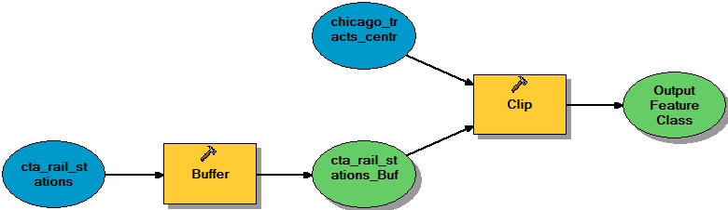
ArcGIS Modelbuilder
ModelBuilder provides a flow diagram interface to start your task
A majority of parameters can and should be set in ModelBuilder
author: Todd J. Schuble, University of Chicago

Slide 14
ArcGIS ModelBuilder
Graphic environment to build a geoprocessing workflow
Use existing tools to create a new framework
  New framework will serve as the basis for your script
author: Todd J. Schuble, University of Chicago

Slide 15
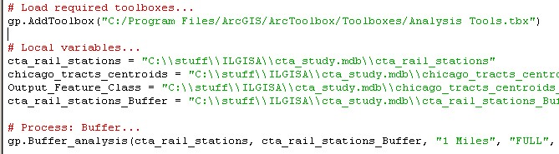
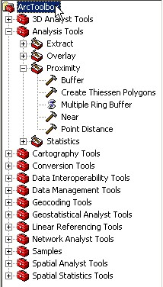
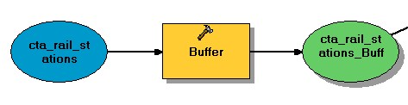
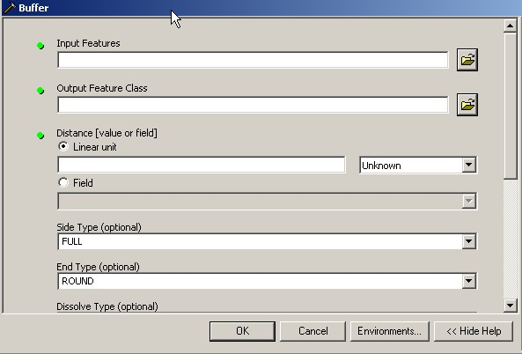
ArcGIS ModelBuilder
Scripts
Models
Tool dialog
author: Todd J. Schuble, University of Chicago

Slide 16
ArcGIS ModelBuilder
Basic steps to begin scripting
  Create new toolbox
  Create new model within toolbox
  Build a model (as complete as possible)
  Test model in ModelBuilder
  Export script to Python for more modification
author: Todd J. Schuble, University of Chicago

Slide 17
ArcGIS ModelBuilder
Searching for more help on ModelBuilder?
  HELP MENU
  Search terms: model builder
  http://resources.arcgis.com
  Textbook: Getting to Know ArcGIS Modelbuilder
**DATA WARNING** when using ModelBuilder or scripting in Python: USE GEODATABASE
  Using shapefiles and coverages is not suggested or encouraged…can cause problems
  SDE geodatabase, file geodatabase, personal geodatabase
author: Todd J. Schuble, University of Chicago

Slide 18
LET’S BUILD IT!
author: Todd J. Schuble, University of Chicago

Slide 19
Python Interface
Multiple ways to edit Python scripts
  IDLE – a cross-platform Python development environment
  Other Python editors: PyCharm, Notepad++, etc.
  PythonWin – a Windows only interface to Python
  Python Shell – running 'python' from the Command Line opens this interactive shell
author: Todd J. Schuble, University of Chicago

Slide 20
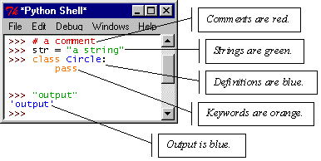
Python Interface
Editors helps you program in Python by:
  color-coding your program code
  debugging
  auto-indent
  interactive shell
author: Todd J. Schuble, University of Chicago

Slide 21
Translating Python
ModelBuilder produces Python scripts in a specific format
  Description, software and library settings, variable settings, functions
Descriptions
  Name of script
  When it was created
  Generated by ModelBuilder
Import system modules or libraries
  Statement references how Python will communicate with its libraries and operating system
  http://help.arcgis.com/en/arcgisdesktop/10.0/help/index.html#/Importing_ArcPy/002z00000008000000/
author: Todd J. Schuble, University of Chicago

Slide 22
Translating Python
ArcGIS 10.x:
  # Import arcpy module
  import arcpy
ArcPy opens modules including:
  Data access module (arcpy.da)
  Mapping module (arcpy.mapping)
  Geostatistical Analyst module (arcpy.ga)
  ArcGIS Spatial Analyst module (arcpy.sa)
  ArcGIS Network Analyst module (arcpy.na)
author: Todd J. Schuble, University of Chicago

Slide 23
Translating Python
import arcpy #imports ArcGIS geoprocessing functionality
import arcpy.mapping #imports only the mapping module
import os #imports Python’s core operating system
import sys #variables/functions used or maintained by the interpreter
from arcpy import env #ability to control ArcGIS environment
  env.workspace = “C:\data”
from arcpy.management import *
#content imported into namespace. Can use content without prefix
author: Todd J. Schuble, University of Chicago

Slide 24
Variables
Setting variables
  Variables must be declared before they are used in the script
  Informs script of the type of object and its “gender”
  Feature classes, values, etc.
Declaring variables
  x = 1 or x = 1.0 or x = 1.11 or x = “GIS”
  The type of variable is defined by the value it is assigned (integer, decimal, string, etc.)
Manipulating variables
  Computation (+) (-) (*) (/)
  Concatenation
    x = “GIS”,y = “class” … x +“ ”+ y=‘GIS class’
author: Todd J. Schuble, University of Chicago

Slide 25
Variables
Changing variable types
  Numeric and character data cannot be joined unless they are the same type
    x=15, y = ‘Your score is: ‘
    x + y = ERROR
  Conversion functions
    int(x): integer, long(x): long integer, float(x): float/decimal, str(x): character string
author: Todd J. Schuble, University of Chicago

Slide 26
Variables
Declaring multiple variables in one line
  x=1
  y = 2
  z =3
  Can be written as….x, y, z = 1, 2, 3
Change upper and lower case strings
  x = “Todd”
  x = lower(x)
  x = upper(x)
author: Todd J. Schuble, University of Chicago

Slide 27
ArcObjects
ArcGIS is made of many types of ArcObjects
These include: features, layers, maps, map documents, applications
Even tables, their fields, and rows are ArcObjects
Each of these ArcObjects has its own properties and methods, through which it interacts with other ArcObjects
ArcObjects can be manipulated with ArcPy
author: Todd J. Schuble, University of Chicago

Slide 28
ArcObjects
Manipulating ArcObjects requires knowing their properties
Map
Feature Class
Properties
  Layer count
  Name
  Spatial
Reference
  Map scale
  Extent
Methods
  Add layer
  Clear selection
  Select feature
Properties
  Shape type
  Spatial
Reference
  Extent
Methods
  Create feature
  Remove feature
author: Todd J. Schuble, University of Chicago

Slide 29
Environments
We set the environment for tools to use them
This includes setting the current workspace, output spatial reference, extent, raster analysis setting (cell size, mask)
  arcpy.env.workspace
  arcpy.env.outputCoordinateSystem
  arcpy.env.extent
  arcpy.env.cellSize
  arcpy.evn.mask
author: Todd J. Schuble, University of Chicago

Slide 30
Environments
Add buffer around the road feature class with given distances
  import arcpy
  arcpy.env.workspace = ”C:\data\City.gdb” #sets the workspace
  fc = “Roads” #variable feature class
  distanceList = [“100 meters”, “200 meters”, 400 meters”] #distances
Loops through each distance in the distanceList
Takes the first distance and puts it in variable dist, and repeats it 3 times
  for dist in distanceList:
    outName = fc+” _”+ dist
    arcpy.Buffer_analysis (fc, outName, dist) #outputs the feature class, its output name_distance
    # breaks out of the loop
  print “Buffering completed!”
author: Todd J. Schuble, University of Chicago

Slide 31
Python Syntax
Straight-forward and logical
  # designates a comment line
  print designates a print statement
Normal mathematical operators
  +, -, =, /, *, >, <, etc.
Character string operators
  “ ”, ‘ ’…designate a string
  +, & …concatenate
  ==…equivalent
author: Todd J. Schuble, University of Chicago

Slide 32
Python Syntax
Python uses whitespace and indents to denote blocks of code
Lines of code that begin a block end in a colon:
Lines within the code block are indented at the same level
To end a code block, remove the indentation
author: Todd J. Schuble, University of Chicago

Slide 33
Python Syntax
A colon and line indentation designates nesting
    #This script will calculate distance.
    for x in range(10):
    distance = 2 * x
    print distance
  print “I learn so much at GIS conferences.”
author: Todd J. Schuble, University of Chicago

Slide 34
Translating Python
Calling functions
  Very similar to calling functions from a command line
  Help menu provides syntax for ALL functions
  Ex. Buffer function
    Buffer_analysis (in_features, out_feature_class, buffer_distance_or_field, line_side, line_end_type, dissolve_option, dissolve_field)
author: Todd J. Schuble, University of Chicago

Slide 35
Functions
Functions perform useful tasks
  Accessing geoprocessing tool messages (GetMessages)
  Listing data for batch processing
    ListFeatureClasses, ListFields, plus nine other list functions
  Retrieving a dataset’s properties (Describe)
import arcpy
# Set the workspace for ListFeatureClasses function
arcpy.env.workspace = “c:/test”
# For each feature class, create a scratch name and clip
for fc in arcpy.ListFeatureClasses ():
outName = arcpy.CreateScratchName (“clipped_” + fc, “”, “featureclass”, arcpy.env.workspace)
arcpy.Clip_analysis(fc, “boundary”, outName)
author: Todd J. Schuble, University of Chicago

Slide 36
Dealing with Functions/Methods
Assigning a value to a property:
  #object.property = value
  env.workspace = “C:/Temp”
Return the value of a property:
  #object.property
  print “The workspace is “ + env.workspace
Use a method:
  #object.method (arg1, arg2, …) e.g., put a buffer for a road:
  arcpy.Buffer_analysis(“c:/input/roads.tif”,“c:/output.gdb/buffer_output”, 100)
author: Todd J. Schuble, University of Chicago

Slide 37
Describe Function
Takes some feature class, table, raster image (e.g., properties: type, number of bands, resolution), database, workspace, and describe it
  Find how many fields a table has, what is their type and name
Returns an object with dynamic properties
Allows script to determine properties of data
  Data type (shapefile, coverage, network dataset, etc)
  Shape type (point, polygon, line)
  Spatial reference
  Extent of features
  List of fields
author: Todd J. Schuble, University of Chicago

Slide 38
Describe Function
Returns the shape type (point, line, polygon) of a feature class
  desc = arcpy.Describe (featureClass)
  OR
  d = arcpy.Describe (“c:/base.gdb/rivers”)
Branches based on input’s shapeType property:
  if d.shapeType == “polygon”:
    arcpy.FeatureToLine_management (inFC, outFC)
  else:
    arcpy.CopyFeatures_management (inFC, outFC)
Print selected feature class properties
  print “shapeType”. desc.shapeType
  print “the first field’s name”, desc.fields[0].name
  print “the first field’s type”, desc.fields[0].type
author: Todd J. Schuble, University of Chicago

Slide 39
List Functions
Get a list of feature classes, tables, rasters, etc.
Process data using a loop through the list
#returns a list of feature classes, tables
#for examples all the tables in a geodatabase, or fields in a table
fcList = arcpy.ListFeatureClasses()
# copy shapefiles to a file geodatabase one item at a time
# loop through the list of shape files using copy management tool
for fc in fcList:
arcpy.Copy_management (fc, “d/base/output.gdb” + os.set + fc.rstrip(“ .shp”))
author: Todd J. Schuble, University of Chicago

Slide 40
List Functions
Adding to the List
  var[n] = object
    replaces n with object
  var.append(object)
    adds object to the end of the list
Removing from the List
  var[n] = []
    empties contents of card, but preserves order
  var.remove(n)
    removes card at n
  var.pop(n)
    removes n and returns its value
author: Todd J. Schuble, University of Chicago

Slide 41
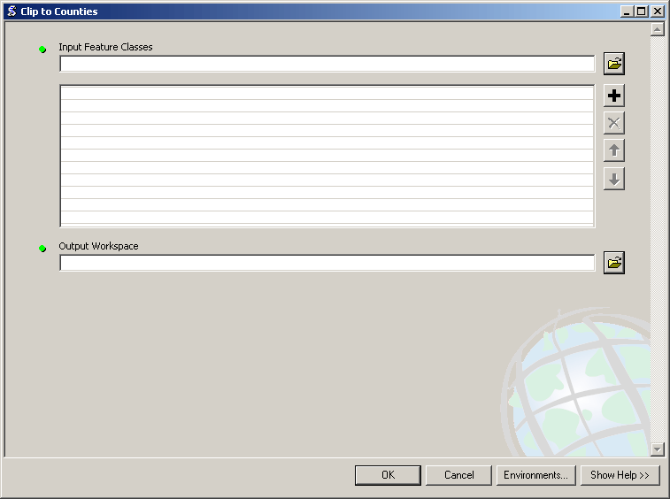
Lists in ArcToolbox
You will create lists:
Layers as inputs
Attributes to match
Arrays of objects
You will work with lists:
List of field names
List of selected features
author: Todd J. Schuble, University of Chicago

Slide 42
Conditional Statements
Conditional and nested conditional statements
  for/in statements
  if/else statements
  try/except statements
  while statements
author: Todd J. Schuble, University of Chicago

Slide 43
Conditional Statements
for/in statements very good for cycling through variables
  for <variable> in <sequence>:
    <body>
  for x in range (10):
    Will repeat body of program 10 times
  for x in [0,1,2,3]:
  for x in [A, B, C, D]:
The variable is set to the specific sequence value until it returns to the beginning of the loop
author: Todd J. Schuble, University of Chicago

Slide 44
Conditional Statements
if/else statements performs conditional functions
  if <true_statement>:
    <body>
  else:
    <body>
if/else can be modified for multiple conditionals with if/elif
  if <true_statement>:
    <body>
  elif <true_statement>:
    <body>
  elif <true_statement>:
    <body>
author: Todd J. Schuble, University of Chicago

Slide 45
Conditional Statements
if/else example asking for user input
  answer = input(“What is 1+1?”)
  if answer == 2:
    print “Good job.”
  else:
    print “Can you spell GIS?”
author: Todd J. Schuble, University of Chicago

Slide 46
Conditional Statements
while statements run a nested loop until a statement is violated
  while <true statement>:
    <body>
Usually prefaced by setting a variable or a condition to violate
  x = 0
  while x >= 0:
    <body>
author: Todd J. Schuble, University of Chicago

Slide 47
Conditional Statements
try/except statements good for error handling
  If error occurs while running a function in a try block, except block takes over
  Usually returns a message, kicks out of script, resets variables, etc.
Diagnosing an error is another issue
author: Todd J. Schuble, University of Chicago

Slide 48
Error Capture
Check for type assignment errors, items not in a list, etc.
Try & Except
  try:
  a block of code that might have an error
  except:
  code to execute if an error occurs in "try"
Allows for graceful failure
  important in ArcGIS
author: Todd J. Schuble, University of Chicago

Slide 49
Error Messages
When executing a tool, usually 3 types of messages:
  Informative messages
  Warning messages
  Error messages
try:
#start try block
arcpy.Buffer (“C:/ws/roads.shp”,“C:/outws/roads10.shp”, 10)
#print the tool messages
except arcpy.ExecuteError:
print arcpy.GetMessages (2)
author: Todd J. Schuble, University of Chicago

Slide 50
Using Cursors
Cursors allows the user to access, update, or create data records through the script
Three types of cursors
  Search cursor
    Read-only access
  Update cursor
    Read/write/delete access, no new records
  Insert cursor
    Read/write access with data creation if necessary
Row objects work with cursors to track which records are being edited
author: Todd J. Schuble, University of Chicago

Slide 51
Python Syntax
Working with tabular calculations
  Function: SearchCursor
  Function: InsertCursor
    newRow
    insertRow
  Function: UpdateCursor
    updateRow
    deleteRow
author: Todd J. Schuble, University of Chicago

Slide 52
Accessing Data with Cursors
There are three types of cursors
  Search Cursor
    Read-only access
  Update Cursor
    Read/Write/Delete access but no new records
  Insert Cursor
    Read/Write access with capability of creating new records
author: Todd J. Schuble, University of Chicago

Slide 53
Accessing Data with a Search Cursor
A row object is returned from the search cursor object
Fields are accessed as properties of the row object
Use the row object’s GetValue and SetValue methods if your field name is a variable
Destroy the row and cursor objects to remove read locks on the data source
author: Todd J. Schuble, University of Chicago

Slide 54
Accessing Data with a Search Cursor
rows = arcpy.SearchCursor("D:/St_Johns/data.gdb/roads")
for row in rows:
# Print concatenated values of road name and road type
print row.name + row.getValue("type")
# Delete the row and cursor objects so no locks remain
del row
del rows
author: Todd J. Schuble, University of Chicago

Slide 55
Accessing Data with Cursors
A where clause may be used to limit the records returned by the cursor
  Same as defining a definition query on a layer
rows = arcpy.SearchCursor("D:/St_Johns/data.gdb/roads",
“[neighborhood] = "Shea_Heights")
# Print concatenated values of road name and road type
for row in rows:
print row.name + row.getValue("type")
del row
del rows
author: Todd J. Schuble, University of Chicago

Slide 56
Insert Cursor
Create a new geometry
  cur = arcpy.InsertCursor (fc)
Create array and point objects
  ptList = [arcpy.Point (358331, 5273193), arcpy.Point (358337, 5272830)]
  lineArray = arcpy.Array(ptList)
Create a new row for the feature class
  feat = cur.newRow ()
  #set the geometry of the new feature to the array points
  feat.Shape = lineArray
  #Insert the feature
  cur.insertRow (feat)
  #Delete objects
  del cur, feat
author: Todd J. Schuble, University of Chicago

Slide 57
Geometry Objects
Create, delete, move, and reshape features
  Create a geometry object and put it in the variable g
  g = arcpy.Geometry ()
  Run the Copy Features tool. set the output to the geometry object
  Return a list of geometry objects (lines, streets)
  geometryList = arcpy/CopyFeatures_management (“c:/data/streets.shp”, g)
  Loop through each geometry, totaling the lengths of the streets
    for geometry in geometryList:
    length += geometry.length #Note: x +=1 means x=x+1
    print “Total length: %f” % length
author: Todd J. Schuble, University of Chicago

Slide 58
Mapping module
arcpy.mapping
  Used to open and manipulate existing map documents (.mxd) and layer files (.lyr)
Query and alter the contents of a map
  Find a layer with data source X and replace with Y
  Updata a layer’s symbology across many MXDs
  Generate a report listing document information
    Data sources, broken layers, spatial reference, etc.
Can print, export, or save the modified document
Allows adding, removing, and rotating data frames, and adding and removing layers
Manipulate properties of map documents and layers
author: Todd J. Schuble, University of Chicago

Slide 59
Manipulate map documents
Modify map document properties, save changes to a layer file, and save changes to the map document
import arcpy
mxd = arcpy.mapping.MapDocument (“input.mxd”)
df = arcpy.mapping.ListDataFrames (mxd)
df.scale = 24000
df.rotation = 2.7
for lyr in arcpy.mapping.ListLayers(mxd):
if lyr.name == “Landuse”:
lyr.visible = True
lyr.showLabels = True
lyr.saveACopy(“output.lyr”)
mxd.save()
del mxd
author: Todd J. Schuble, University of Chicago

Slide 60
Manipulating Layers
Change properties of a layer
  Name, source data, visibility (make it on or off), transparency, label, definition query, display order, etc.
import arcpy
lyrFile = arcpy.mapping.Layer (”C:\Project\Date\Streets.lyr”)
for lyr in arcpy.mapping.ListLayers(lyrFile):
if lyr.name.lower() == “highways”:
#turn its label on
lyr.showLabels = True
lyr.saveACopy (r”C:\Project\Data\StreetsWithLabels.lyr”)
#now the changed layer is saved as different layer
del lyrFile
author: Todd J. Schuble, University of Chicago

Slide 61
Adding a Python Script as a Tool
Add a script as a tool to a toolbox
They become a new tool with all the properties of a tool, e.g.,
  It will return messages, access to all environment settings, and automatically add the output to our map (to the table of contents in ArcMap)
Can easily be shared
Tools automatically create dialog boxes (created by ArcGIS)
Add the tool into the toolbar and menus
author: Todd J. Schuble, University of Chicago

Slide 62
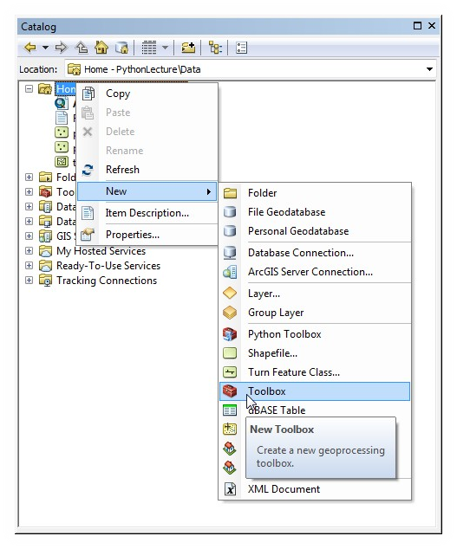
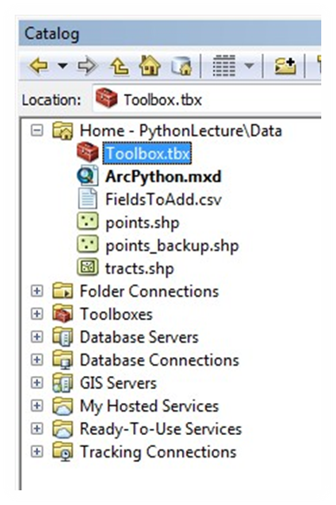
Creating a Custom Toolbox
Empty custom toolboxes can be made in the Catalog pane.
Each toolbox can contain multiple tools
Each tool references a Python script file with the .py extension.
author: Todd J. Schuble, University of Chicago

Slide 63
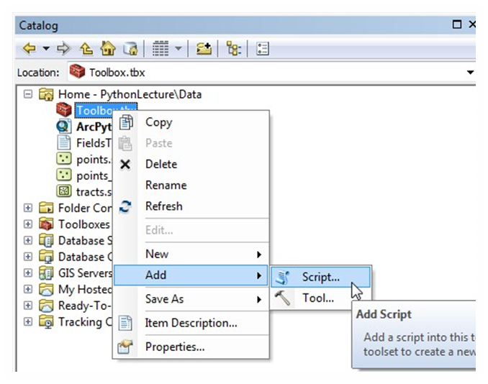
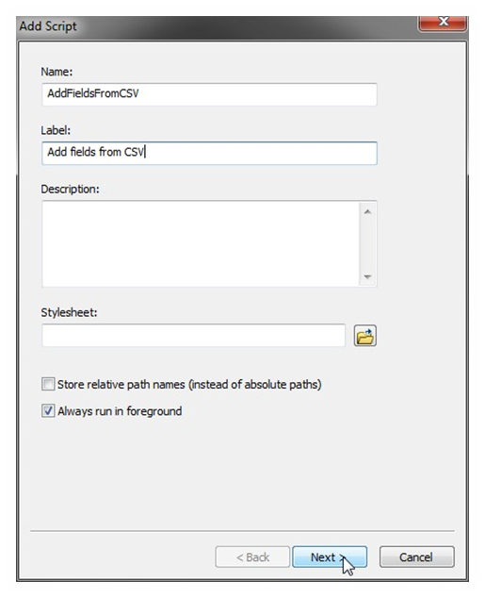
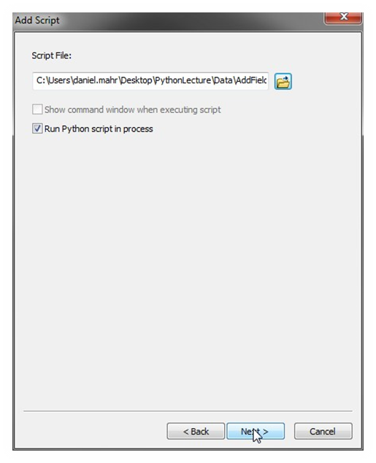
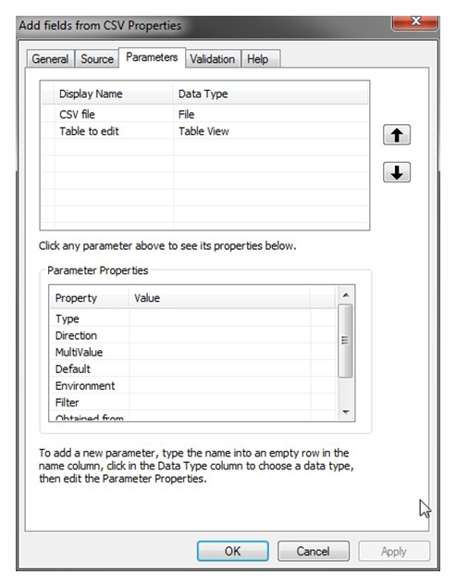
Creating a Custom Toolbox (cont.)
author: Todd J. Schuble, University of Chicago

Slide 64
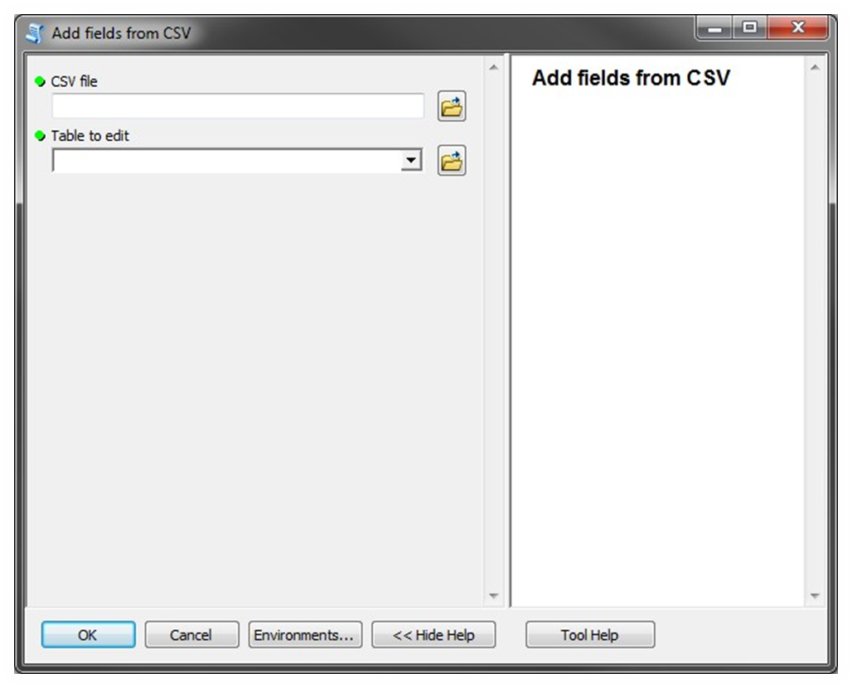
Creating a Custom Toolbox (cont.)
author: Todd J. Schuble, University of Chicago

Slide 65
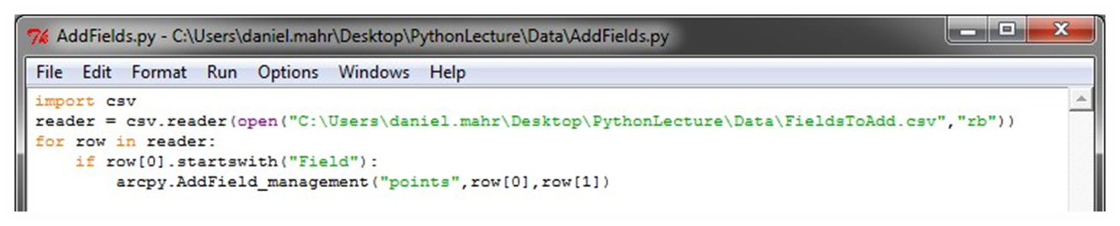

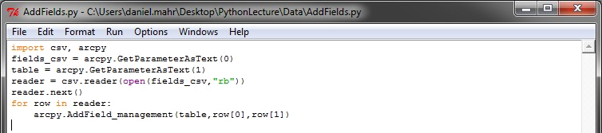
Creating a Custom Toolbox (cont.)
Import arcpy module
Handle header fields more elegantly using next()
Use parameter values from our toolbox tool instead of hardcoded .csv file and table layer.
author: Todd J. Schuble, University of Chicago

Slide 66
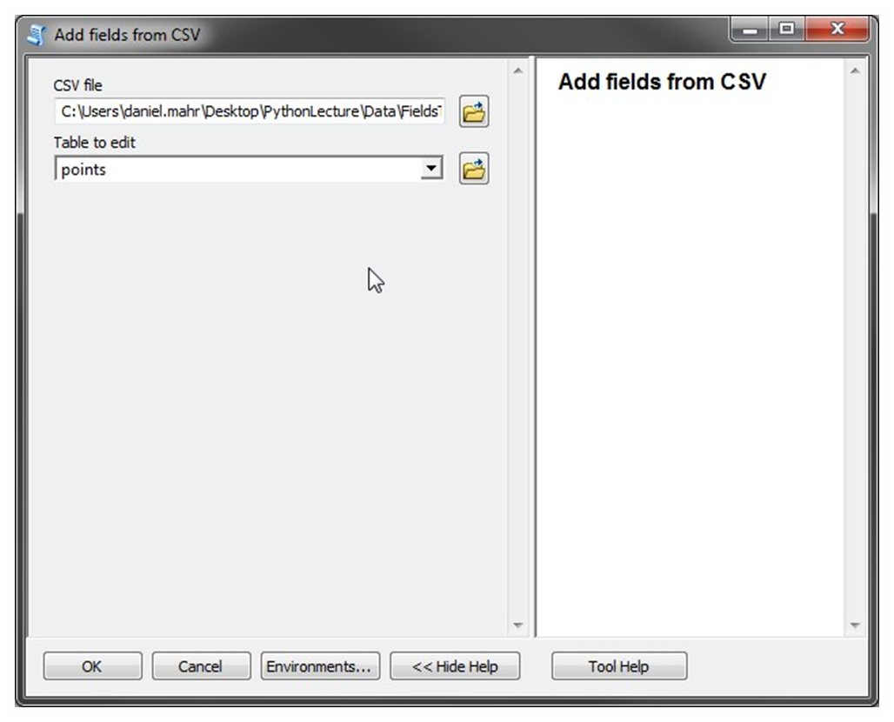
Creating a Custom Toolbox (cont.)
author: Todd J. Schuble, University of Chicago

Slide 67
Read/Write to Files
Files are manipulated by creating a file object
  f = open("points.txt", "r")
The file object then has new methods
  print f.readline() # prints line from file
Files can be accessed to read or write
  f = open("output.txt", "w")
  f.write("Important Output!")
Files are iterable objects, like lists
author: Todd J. Schuble, University of Chicago

Slide 68
Getting Creative with Python
Geocoding data for free
  Python library named GEOCODER
  Function uses Google Maps API to geocode locations
    Google API only allows 2000 records per day per IP address and only 10 records per second
Combine GEOCODER, CSV, and TIME library functions
  Only send 10 requests at a time up to 2000
author: Todd J. Schuble, University of Chicago

Slide 69
Basic Spatial Functions with Python
GeoPandas (http://geopandas.org) includes very useful tools for the novice user
  Make maps, manage projections, manipulate geometry, geocoding, merging/aggregation
  https://automating-gis-processes.github.io/2016/Lesson3-spatial-join.html
author: Todd J. Schuble, University of Chicago

Slide 70
Fun with Spatial Statistics
PySAL allows for spatial stats methods to be implemented with ease
  User must be familiar with how methods work first before jumping in
  http://pysal.readthedocs.io/en/latest/users/tutorials/autocorrelation.html#moran-s-i
Spatial weights, spatial autocorrelation, spatial econometrics, etc.
  Output is no different than you would get in other GIS/spatial analysis software
author: Todd J. Schuble, University of Chicago

